Slide 1
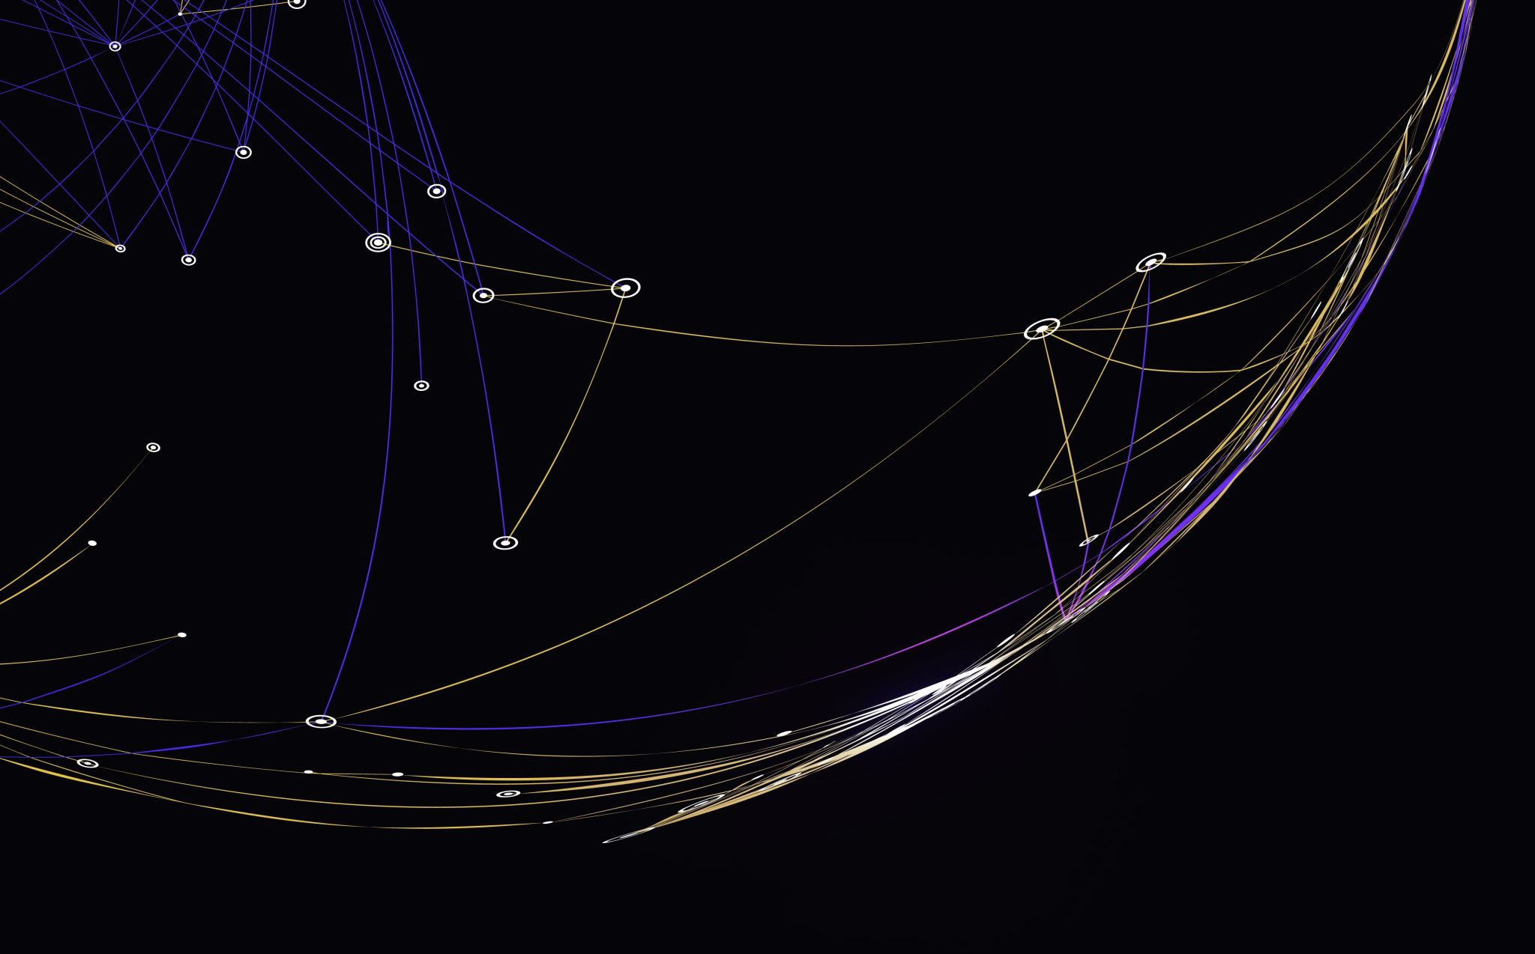
Blockchain
Introduction to blockchain and principles of Decentralizations

Slide 2
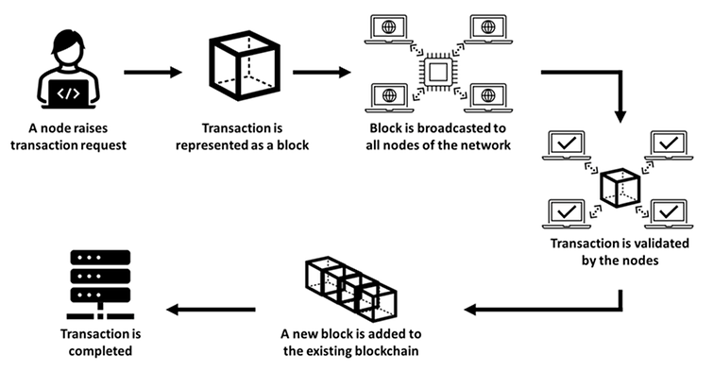
Introduction
Imagine a world where trust is built into the system, where transactions are transparent and secure, and intermediaries are no longer needed. This is the promise of blockchain technology, a revolutionary innovation fundamentally changing our digital landscape.
Blockchain technology works by using a distributed network of computers to verify and record transactions. Each transaction is added to a block, which is then linked to the previous block using cryptography. This creates a chain of blocks, each of which is tamper-proof.
To add a new block to the blockchain, a miner must solve a complex mathematical problem. The first miner to solve the problem gets to add the block to the blockchain and is rewarded with cryptocurrency.

Slide 3
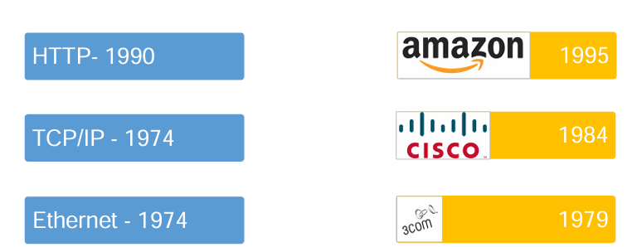
The Internet: Layers of open protocols

Slide 4
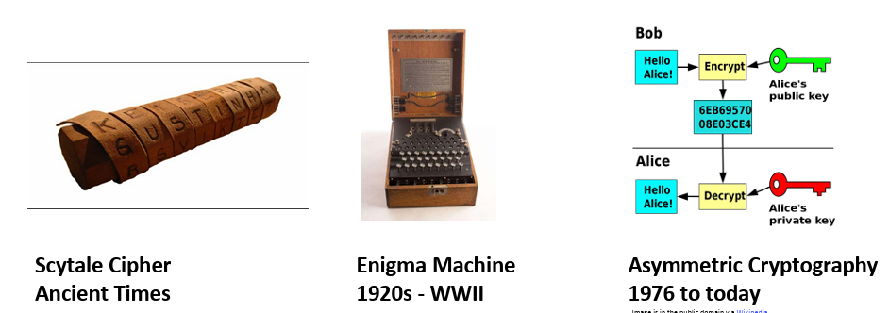
Cryptography: Communications in the presence of adversaries

Slide 5
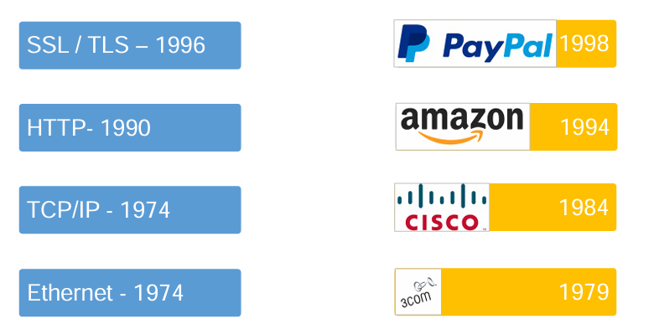
The Internet: Cryptographic protocols

Slide 6
Bitcoin: A Peer-to-Peer Electronic Cash System
From: Satoshi Nakamoto vistomail.com> Subject: Bitcoin P2P e-cash paper Newsgroups: gmane.comp.encryption.general Date: Friday 31st October 2008 18:10:00 UTC • “I've been working on a new electronic cash system that's fully peer-to-peer, with no trusted third party.”

Slide 7
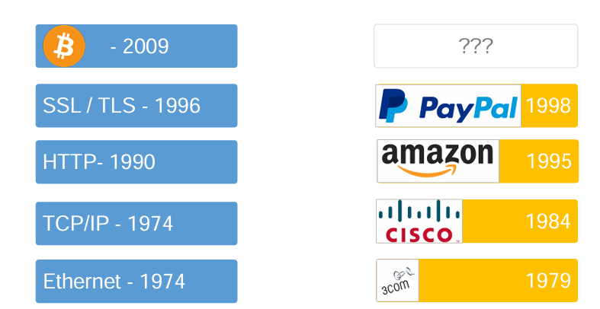
A new layer?: Programmable transactions

Slide 8
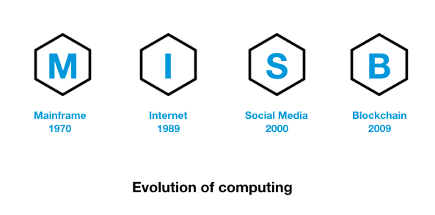
IP Vs Blocks
Everything we do over the internet goes through IP packets in the TCP/IP model. An IP packet is the smallest unit of data that can be sent over the internet. An IP packet has two components, an IP header and a payload.
To send this information, it needs a source and a destination IP addresses. A block is the integral element for this process; it is chained together to form a blockchain. A block also has two components, block header and block body. To send any type of value or transaction, it adds its own digital signature as the source identifier and public key, which resembles the destination's identity in the peer-to-peer network.

Slide 9
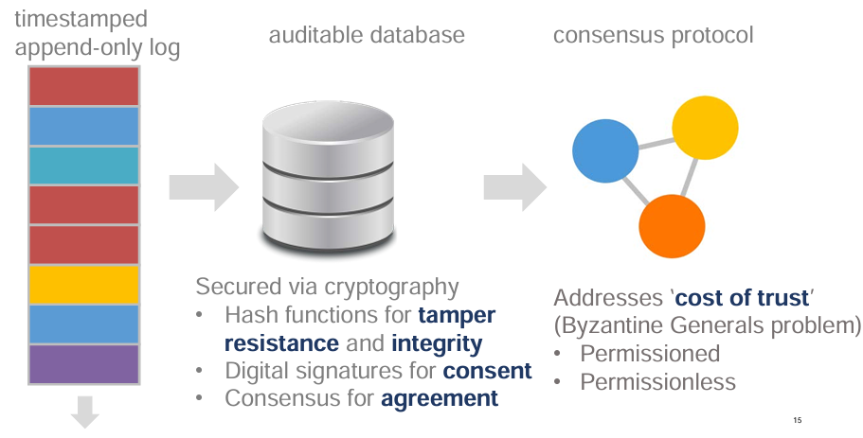
What is a blockchain?

Slide 10
Cont.
Blockchain is a digital ledger shared across a network of computers, storing information in blocks chained together cryptographically. Each block contains data and a unique reference to the previous block, creating an immutable record.
Blockchain is a decentralized database that keeps records of all transactions secure.
Highlight key features:
Decentralization: No single entity controls the network, promoting trust and reducing reliance on central authorities.
Immutability: Records are tamper-proof, ensuring data integrity and security.
Transparency: All participants have access to the ledger, fostering trust and accountability.
Security: Cryptography and consensus mechanisms secure transactions and prevent fraud.

Slide 11
How blockchain works
Transaction preparation: At this stage, party A creates a transaction that includes information including the public address of the receiver, a source digital signature, and a transaction message. Now, this transaction is made available to all of the nodes in the blockchain.
Transaction verification: The blockchain nodes work in a trustless model, where each node (the machine running the blockchain client software) receives this transaction, and verifies the digital signature with party A's public key. After successful verification, this authenticated transaction is parked in the ledger queue and waits until all the nodes successfully verify the same transaction.
Block generation: The queued transactions are arranged together and a block is created by one of the nodes in the network. In the Bitcoin blockchain, Bitcoins are rewarded when a Bitcoin node, also known as a miner, creates a block by solving some mathematically complex problem.
Block validation: After a successful block generation, nodes in the network are processed for an iterative validation process where the majority of the nodes have to acquire consensus.
Block chained: After a successful consensus mechanism, the blocks are verified and are added to the blockchain.

Slide 12
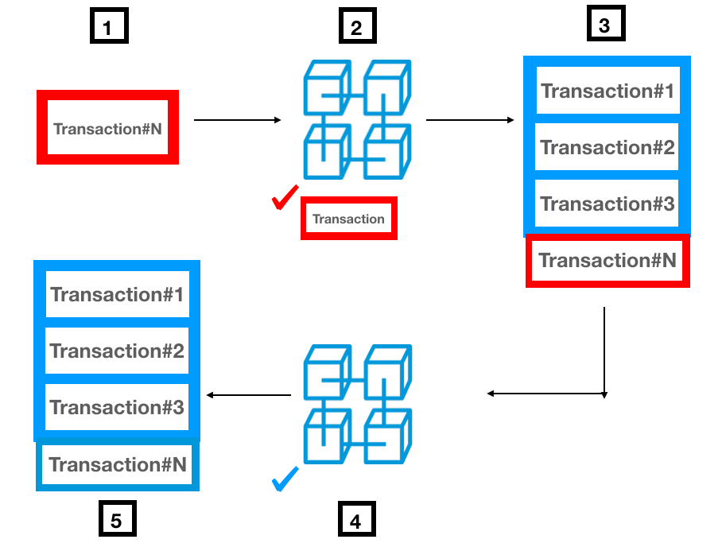
How blockchain works

Slide 13
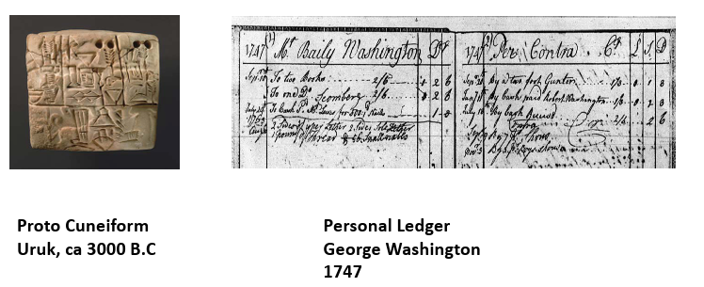
Ledgers (Principal Recordings of Accounts)
Principal Recordings of Accounts:
Economic Activity
Financial Relationships
Types of Ledgers:
Transaction vs. Balance
General vs. Supporting or Sub
Single Entry vs. Double Entry

Slide 14
Characteristics of Good Ledgers
Immutable, Consistency
Timestamped
Ownership
Accuracy
Description of Transaction
Comprehensive

Slide 15
Blockchain is a ledger
Imagine a virtual ledger. Where Each "line" is a bitcoin transaction: sending wallet ID, amount sent, receiving wallet ID, etc. and Each "page" of the ledger is a block.
The ID of each block (equivalent, if you like, to the page number) is generated to include the ID of the previous block, so the blocks can be considered to be 'chained' together.
The ledger (blockchain) contains a record of every single bitcoin transaction that has ever taken place. If you have the patience -- and software -- you can trace every transaction for a specific wallet.
Miners are people or organizations with powerful specialized computers who compete with each other to create the newest block by assembling new, unverified transactions (around 450 of them at the moment), verifying them as described above, generating hash values for each transaction, then generating a series of hash values of each pair of transaction hashes in a pyramid manner until they end up with just one hash. This is called the Merkle root. It is the hash of the hashes of the hashes of the hashes of ........ of the hashes of the transactions. Change one lousy bit in just one transaction and that alters that transaction's hash, which alters the hash of two hashes, and so on up the pyramid, so that the Merkle root also changes.

Slide 16
Cont. Blockchain is a ledger
The miner then concatenates the Merkle root with the ID of the last block and with a random number (the 'nonce') and generates a hash from that. But the hash has to meet certain conditions such as starting with twenty zeros. It almost certainly doesn't, since the chances of that happening are 2 to the power 20 which is a million to one against, so the miner increments the nonce by one and generates a new hash. Once again it probably doesn't meet the condition, so he increments the nonce again and generates a new hash again. This is sort of like buying lottery tickets, with roughly the same chance of winning. He keeps doing this -- often several million times -- until his hash meets the specified condition. When this happens he does the network version of shouting "Bingo!", at which point all the other miners who have been frantically doing the same thing say "rats!", stop what they are doing, pout, check his math, and if it checks out OK they accept his version as the official latest page of the ledger. The hash that met the specified conditions is the ID of the new block.

Slide 17
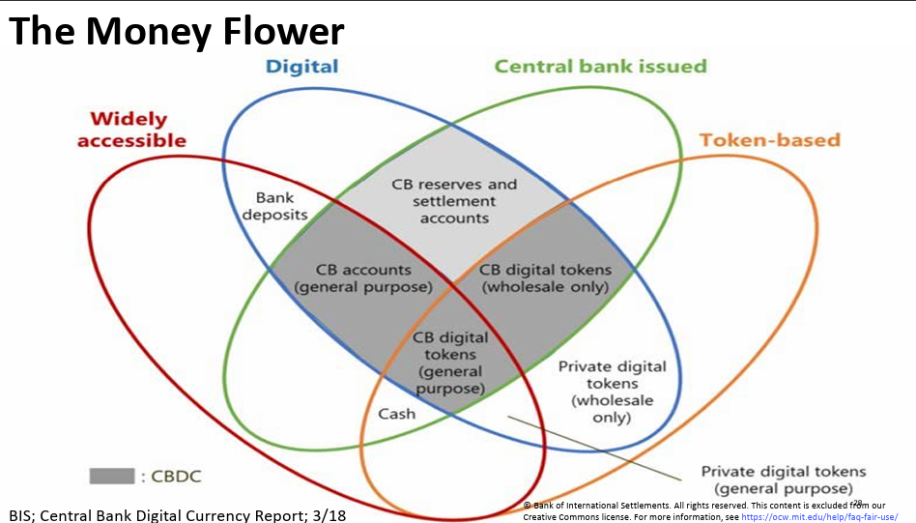
Money and Blockchain
Payment Systems : A Method to Amend & Record Changes in Ledgers for Money
Design of Money :
Token vs. Account Based
Physical vs. Digital
Private Sector vs. Central Bank
Widely Accessible vs. Wholesale
Why did Early Digital Currencies like DigiCash Fail?
Merchant adoption
Centralization
Double spending
Consensus

Slide 18
Bitcoin – Technical Features
Cryptographic Hash Functions
Timestamped Append-only Logs (Blocks)
Block Headers
Asymmetric Cryptography & Digital Signatures
Addresses
Consensus through Proof of Work (POW) or Proof of Stack (POS)
Network of Nodes
Native Currency (Crypto currency of the Network)
Transaction Inputs & Outputs
Scripting language

Slide 19
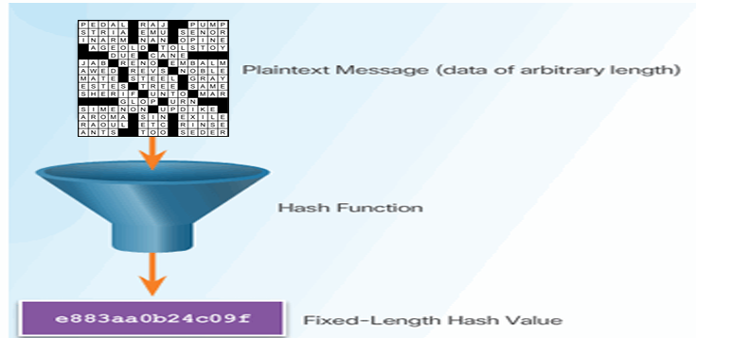
Cryptographic Hash Functions
A Digital Fingerprints for Data and One-Way Data Compression
General Properties
Maps Input x of any size to an Output of fixed size – called a ‘Hash’
Deterministic: Always the same Hash for the same x
Efficiently computed
Cryptographic Properties
Preimage resistant (One way): infeasible to determine x from Hash(x)
Collision resistant: infeasible to find and x and y where Hash(x) = Hash(y)
Avalanche effect: Change x slightly and Hash(x) changes significantly
Puzzle friendliness: knowing Hash(x) and part of x it is still very hard to find rest of x

Slide 20
Cont. Cryptographic Hash Functions
Uses as
Names
References
Pointers
Commitments
Bitcoin Hash Functions
Headers– SHA 256
Bitcoin Addresses – SHA 256 and RIPEMD160

Slide 21
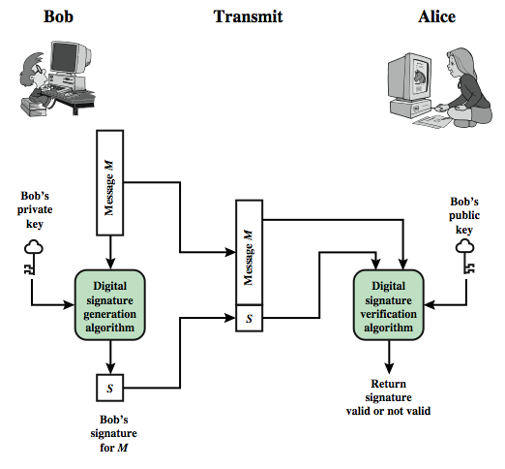
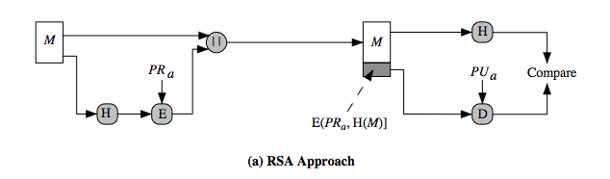
Asymmetric Cryptography & Digital Signatures
Digital Signature Algorithms
Generate Key Pair - Public Key (PK) & Private Key (PR) - from random number
Signature – Creates Digital Signature (Sig) from message (m) and Private Key (PR)
Verification – Verifies if a signature (Sig) is valid for a message (m) and a Public Key (PK)
Properties
Infeasible to find Private Key (PR) from Public Key (PK)
All valid signatures verify
Signatures infeasible to forge
Bitcoin Digital Signature Function
Elliptic Curve Digital Signature Algorithm (EDCSA)

Slide 22
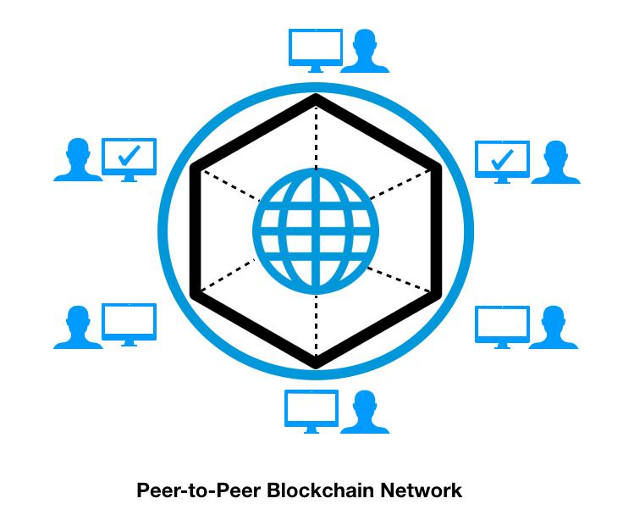
The building blocks of blockchain
A distributed ledger is stored in a database and updated by each participant in the blockchain network. A ledger is represented in a series of units called blocks. The blockchain network consists of a network of several independent machines named nodes. Unlike traditional databases that store entire information on a centralized database server, Blockchain nodes keep the copy of the entire database with an administrative role. Even if one node goes down, the information will remain available for the other nodes.
The moment a node joins the blockchain network, it downloads the updated blockchain ledger. Each node is responsible for managing and updating its ledger with validated blocks. The node maintains the ledger and organizes it in the form of blocks connected to the hashing algorithm.

Slide 23
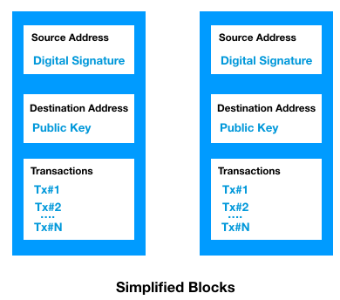
Cont. The building blocks of blockchain
Multiple transactions are bundled together to form a block, and in its simplest form, it's a data structure. Every cryptocurrency has its own blockchain with its own customized properties. For example, a block in a Bitcoin blockchain is generated every 10 minutes and the size of each block is 1 MB, whereas a block in an Ethereum blockchain is generated every 12-14 seconds, and the size of each block is 2 KB.

Slide 24
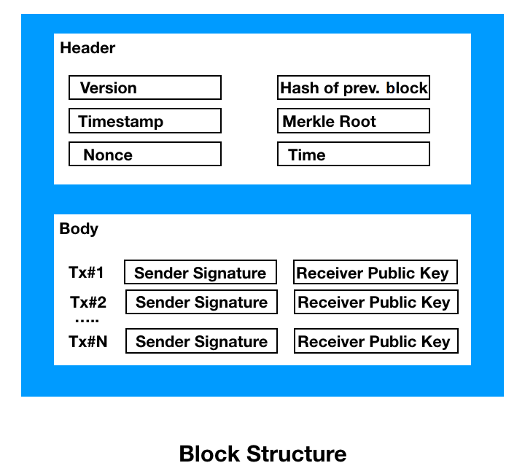
Cont. The building blocks of blockchain
Block header: A block header helps us identify a specific block in the blockchain. It contains a set of metadata: The components of the block are explained as follows:
Version: It's a 4-byte field that's used to track software or protocol
grades.
Timestamp: This is a 4-byte field that indicates the creation time of the block in seconds.
Hash of the previous block: This is a 32-byte field that indicates the hash of the previous block in the chain.
Nonce: This is a 4-byte field that's used to track the PoW algorithm counter.
Hash of Merkle root: This is a 32-byte field that is a hash of the root of the Merkle tree of the block transaction.
Block body: This part of the block consists of a list of transactions. In the Bitcoin world, one block consists of more than 500 transactions on average. Each transaction has to be digitally signed; otherwise, it is treated as invalid. To do that, a hashing function is used to apply the algorithm over an actual transaction with a private key/secret key.

Slide 25
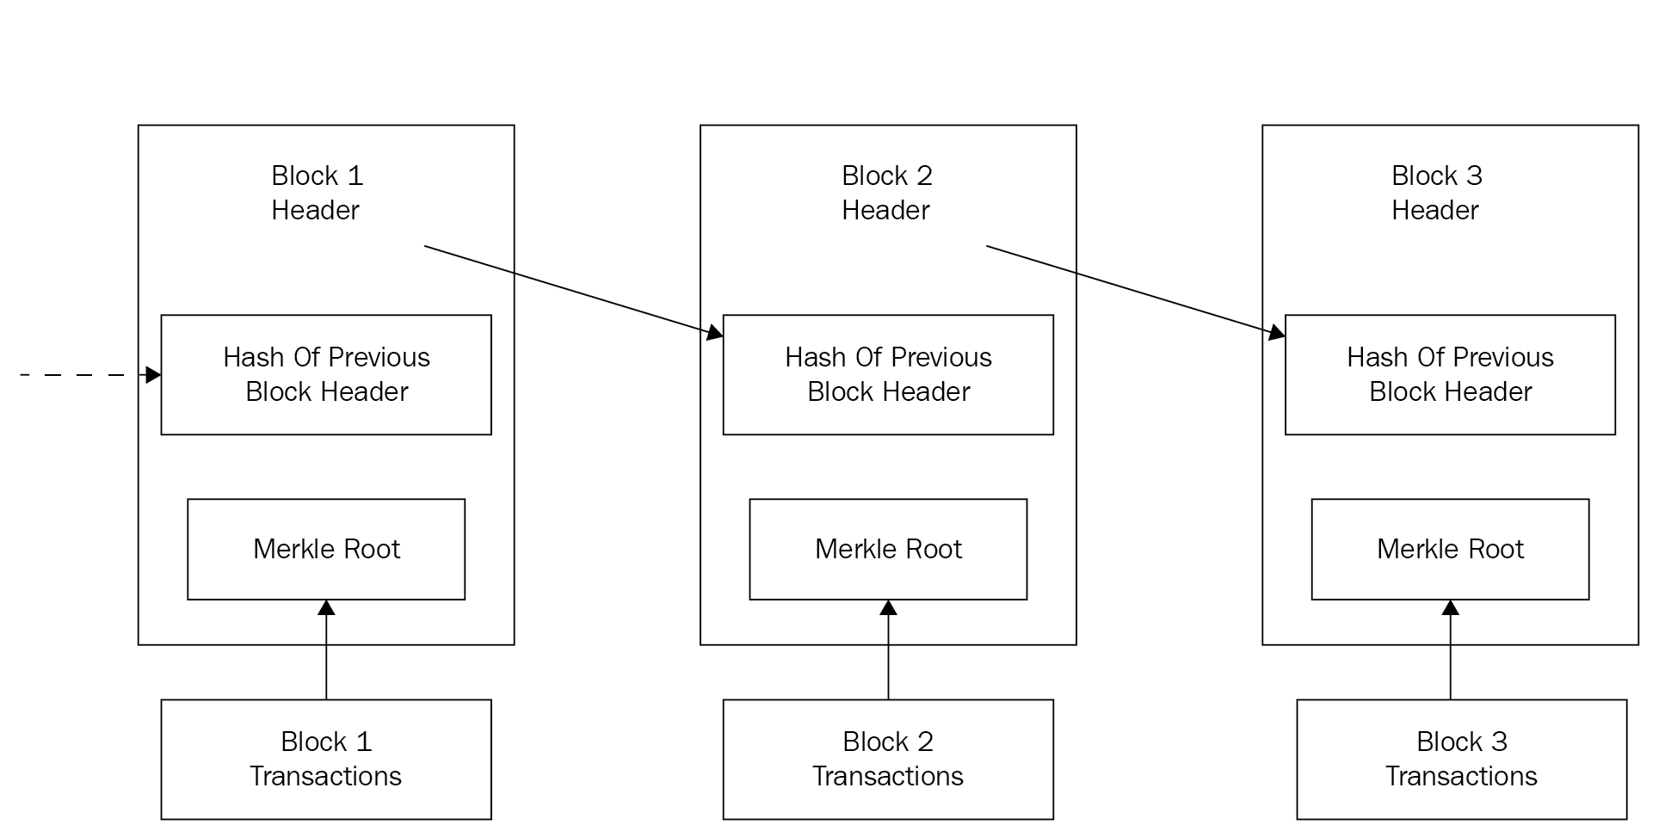
Blockchain chain
In blockchain, a node arranges the entire ledger in the form of chronologically connected blocks. To ensure that the ledger remains tamper-proof, each block is made dependable on the previous block. In other words, a new block can't be produced without having the hash of a previous block. Before adding a new block in the ledger, this has to be approved and verified by every node in the blockchain. This allows anyone to tamper or alter with the ledger except in the case of a hacker, who is capable enough of infecting and compromising all of the millions of nodes in the blockchain at the same time. Only the first block called the genesis block is produced itself and points to itself

Slide 26
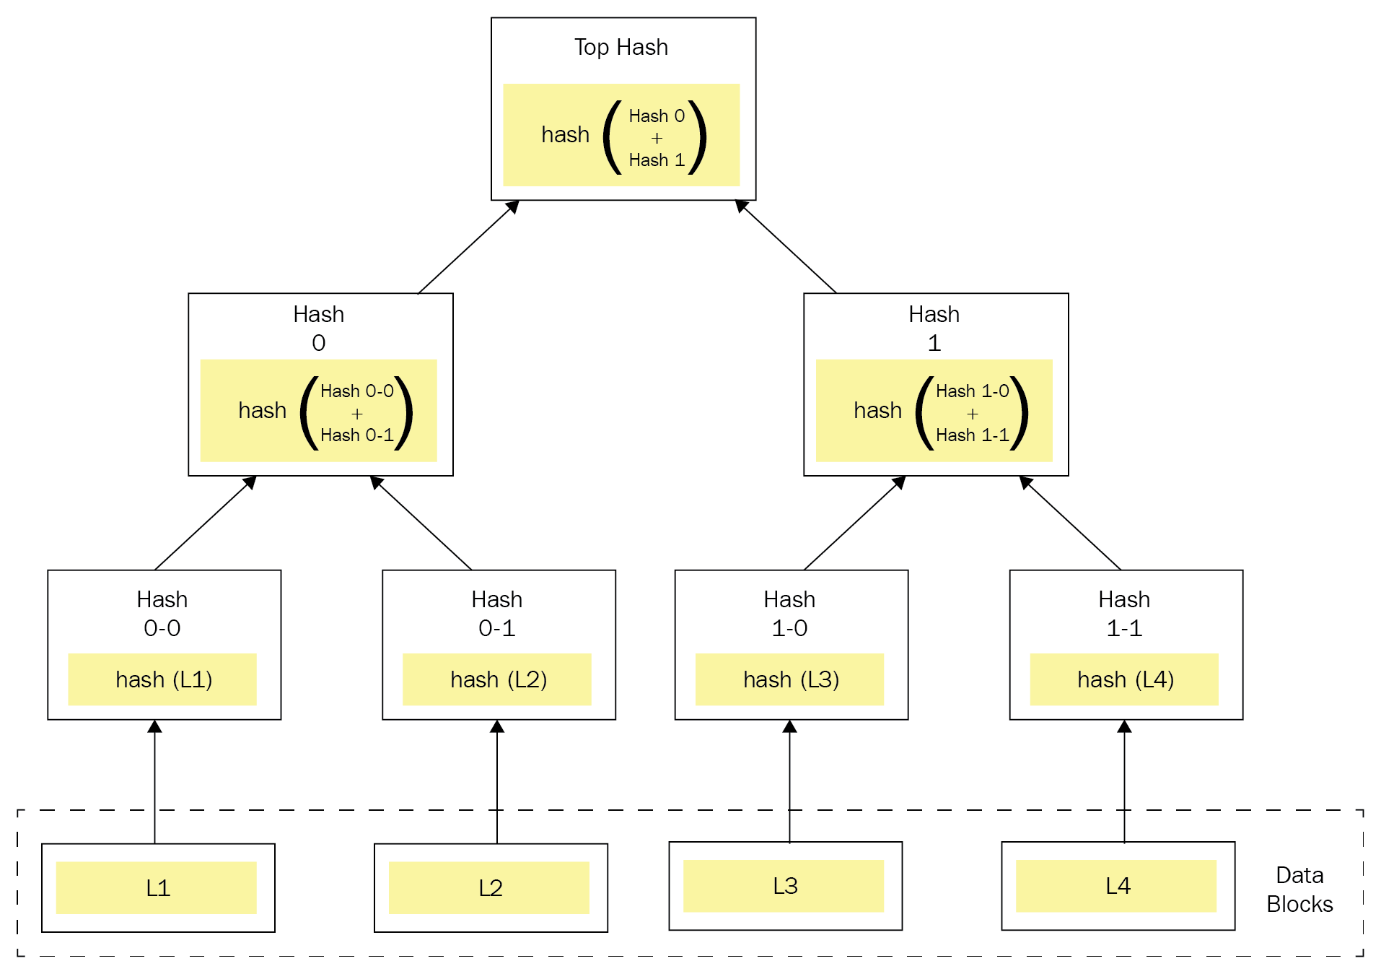
Merkle tree
Every block points to the hash of the previous hash block, and this becomes the backbone of the blockchain's immutable system. Now, even if a block in between is altered or disturbed by any means, a hacker can never achieve the same blockchain as a small change in the block can result in a drastic change in the resulting hash. With thousands upon thousands of transactions in every block, it becomes extremely difficult to find one transaction that won't be time consuming and process-sensitive. To avoid this complex work, a comprehensive hash tree has been developed named the Merkle tree.

Slide 27
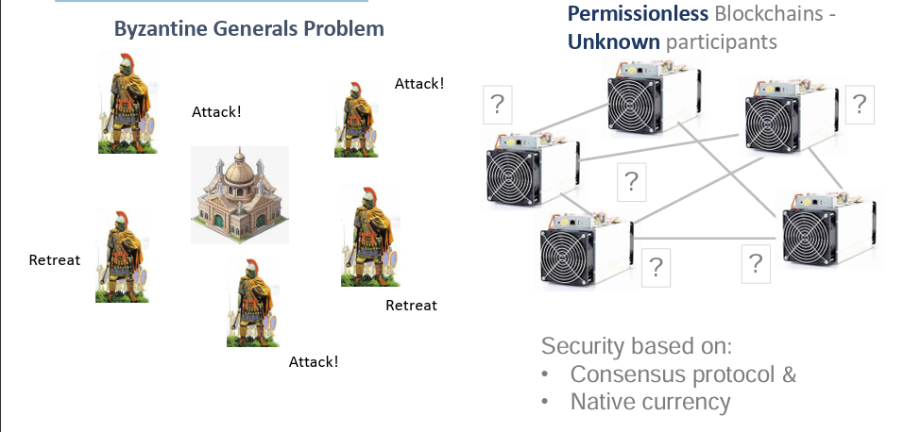
Decentralized Networks
Imagine a network where no single entity controls the information or operations. That's the essence of decentralized networks. They distribute data, applications, and processes across a network of independent nodes, often computers or devices, spread geographically. No central authority dictates the rules or holds ultimate power.

Slide 28
Characteristics of Decentralized Networks
Distributed Ledger: Information is stored and shared across a distributed ledger, like a blockchain, ensuring transparent and tamper-proof records.
Consensus Mechanisms: Nodes agree on the network's state and validate transactions through mechanisms like Proof-of-Work or Proof-of-Stake.
Peer-to-Peer Interactions: Nodes directly communicate and interact with each other, eliminating the need for intermediaries.
User Ownership: Users often own and control their data, participating in network governance through community-driven decision-making.

Slide 29
Benefits of Decentralized Networks
Transparency: Increased visibility and public auditability of transactions and data.
Resilience: No single point of failure makes the network resistant to censorship and outages.
Security: Data encryption and distributed storage enhance security and privacy.
Empowerment: Users control their data and participate in network governance.
Innovation: Open and collaborative environment fosters innovation and new applications.

Slide 30
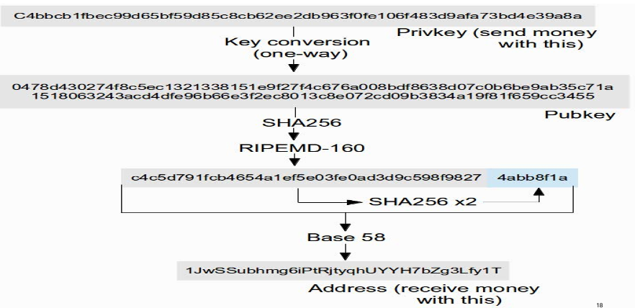
Bitcoin Addresses Example

Slide 31
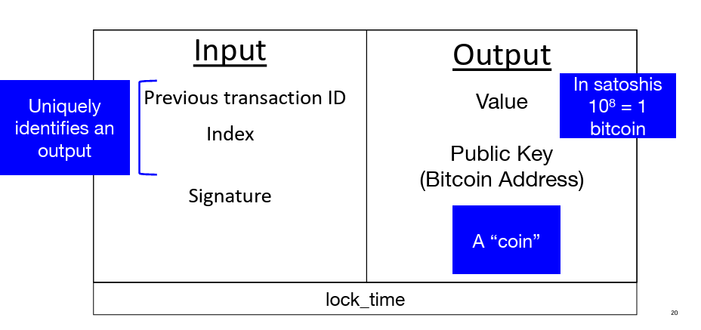
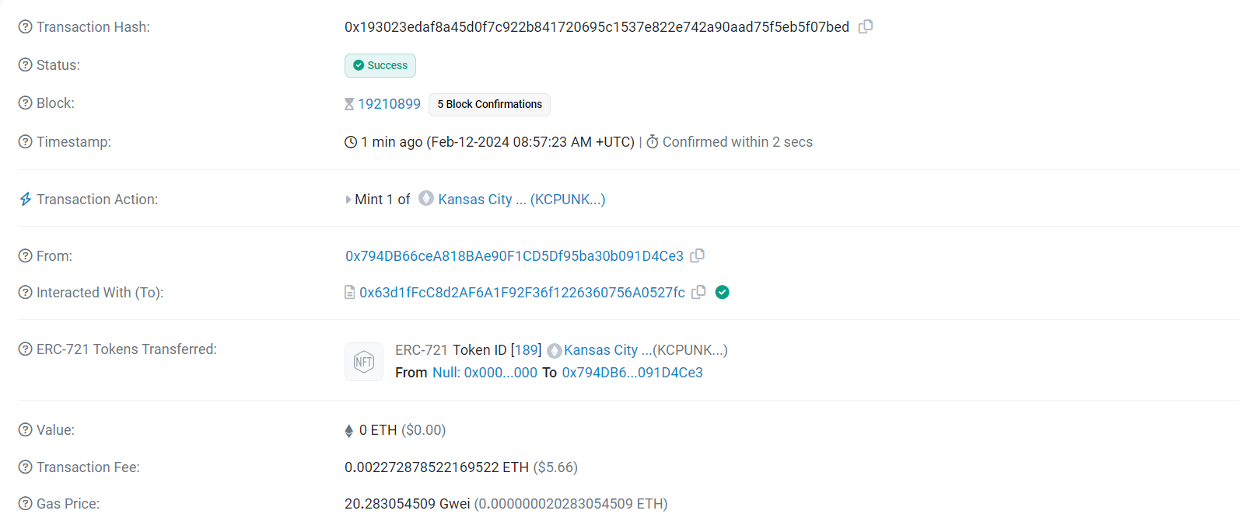
Transaction format
Notes:
https://etherscan.io/

Slide 32
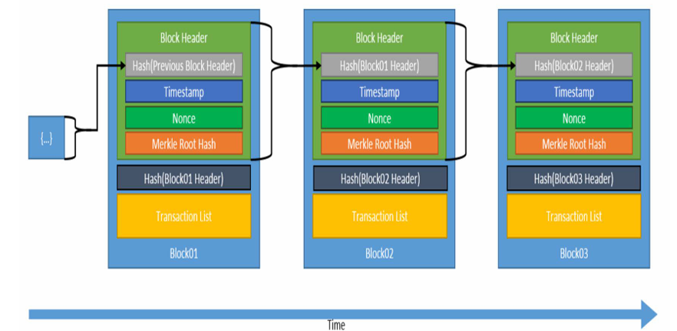
Timestamped Append-only Log - Blockchain
Block Header
Version
Previous Block hash
Merkle Root hash
Timestamp
Difficulty target
Nonce
Notes:
https://andersbrownworth.com/blockchain/distributed

Slide 33
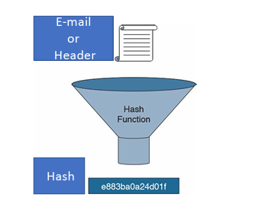
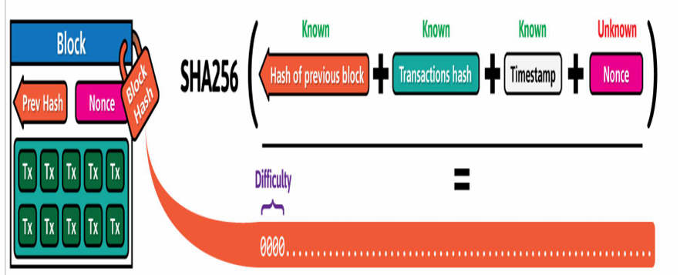
Proof of Work
Hashcash - Proof of Work (Adam Back, 1997) :
Proposed to address E-mail Spam and Denial of Service attacks
Requires computational work to find a hash within predetermined range
Difficulty defined by Hash outputs’ # of leading zeros
Proof of Work can be Efficiently Verified
Blockchain – Proof of Work
Proof of work is the most common consensus mechanism used in blockchains. It is a computationally intensive process that requires miners to solve complex mathematical problems to add new blocks to the blockchain.

Slide 34
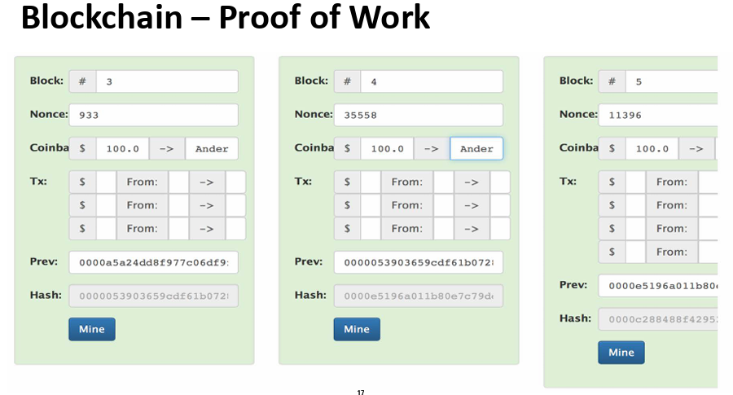
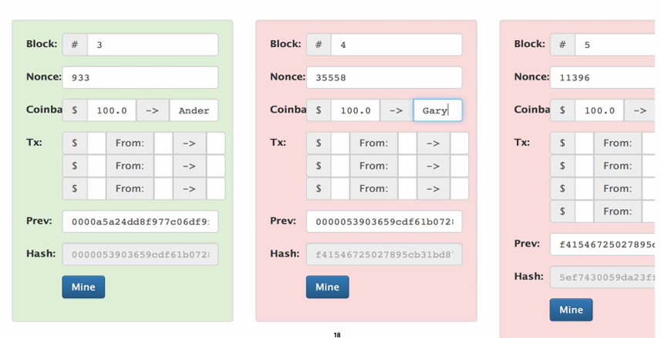
Cont.

Slide 35
Bitcoin Proof of Work Difficulty
• Targets 10 minute average block generation time
• Defined by the # of leading zeros Hash output requires to solve proof of work
• Adjusts every 2016 blocks - about every two weeks
• Currently, > 18 leading zeros (out of 64 hexadecimal characters)
• Block 541974 (9/18/18)- 18 leading zeros 0000000000000000001104a863046dfbad1a2941128815669623ff93c2a3945f

Slide 36
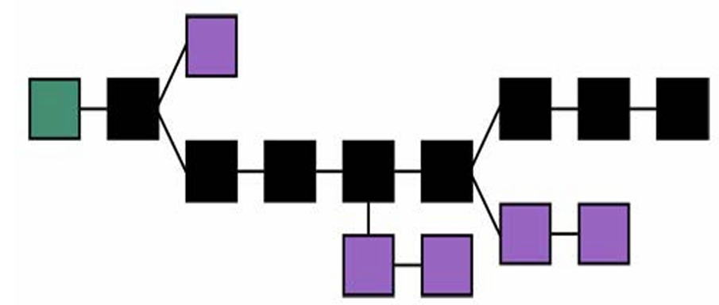
Blockchain – Consensus supports Longest Chain
“ The majority decision is represented by the longest chain, which has the greatest proof-of-work effort invested in it. — Satoshi Nakamoto”
Notes:
https://learnmeabitcoin.com/technical/longest-chain

Slide 37
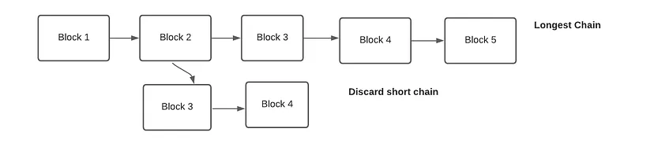
Cont.
Longest Chain Rule:
Imagine the blockchain as a chain of blocks, each holding data and linked to the previous one. The Longest Chain Rule dictates that the chain with the most cumulative computational effort behind it, represented by the most blocks, is considered the true and valid chain.
Miners or validators dedicate computing power to solve complex puzzles, adding new blocks to the chain. The longer the chain, the more work went into building it, making it harder to tamper with or create a competing chain.
This rule incentivizes honest participation, as miners are rewarded for contributing to the longest chain, ensuring network security and consistency.
This rule ensures that the majority of participants agree on the state of the blockchain.
It Protecting blocks already mined on to the blockchain. it is very difficult to replace blocks (and therefore transactions) in the chain.

Slide 38
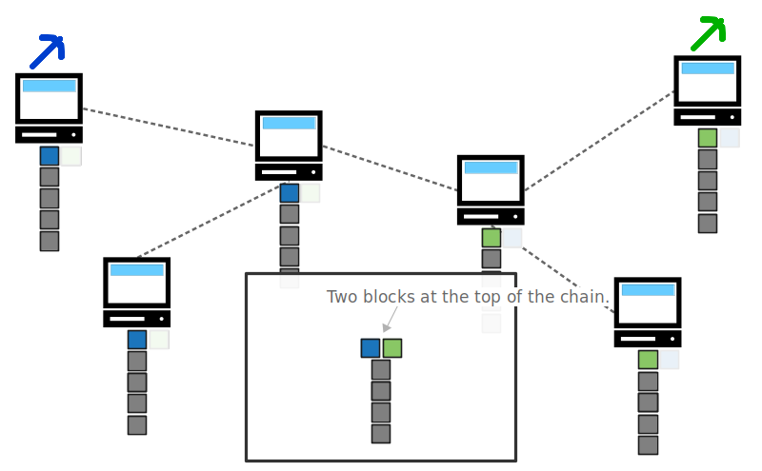
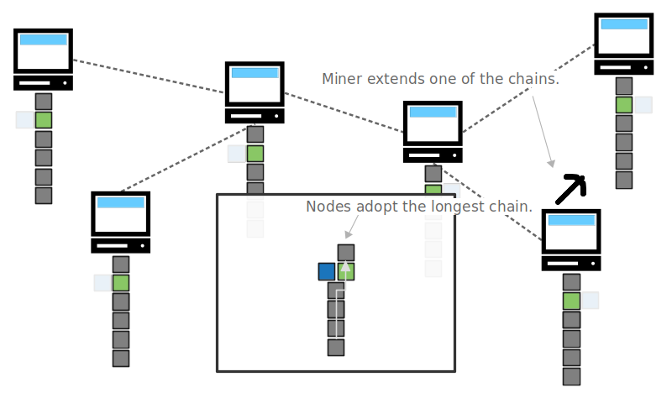
Cont.
If 2 Blocks maintained at the same time by different nodes, each of them tells the other nodes he is the last block so in that case we will wait for confirmation blocks which are new mined blocks added to one of those chains and the longest chain remains the correct one and the other chain will get ignored and also, it’s transaction will be rejected (no reward for the ignored block in that case)
So, its important to waiting for confirmation blocks that confirm that the block which holds my transaction is accepted by the nodes.

Slide 39
51% Attack
Although the longest chain is generally secure, a potential vulnerability exists: the 51% attack. It occurs when a malicious actor gains control of more than 50% of the network's mining or validation power.
With majority control, they can:
Prevent legitimate transactions from being confirmed: Their blocks would be added faster, overtaking the legitimate chain.
Reverse past transactions: By rewriting past blocks on their controlled chain, they could potentially steal or manipulate funds.
However, launching a 51% attack is often prohibitively expensive and requires significant resources. The larger and more decentralized the network, the harder and more costly it becomes to achieve.
The 51% attack remains a theoretical threat, but its difficulty grows with network size and decentralization.
To address these flaws, various solutions have been proposed. These include implementing alternative consensus algorithms like proof-of-stake, which reduces the risk of 51% attacks, and establishing mechanisms to resolve forks through community governance.

Slide 40
Blockchain Forks
What are Forks?
Imagine the blockchain as a road: everyone agrees on the path it takes. A fork occurs when the road splits – the network diverges into two paths. This can happen for various reasons:
Hard Forks: Introduced intentional changes to the protocol, requiring all users to upgrade to the new version. These can be controversial, sometimes leading to permanent splits like Ethereum and Ethereum Classic.
Soft Forks: Introduce backward-compatible changes, meaning older versions can still interact with the updated network. These are generally smoother transitions.
Notable Ethereum Forks:
The DAO Fork (2016): A security exploit on a smart contract prompted a hard fork to reverse the exploit and protect user funds. This resulted in two blockchains: Ethereum and Ethereum Classic.
Byzantium (2017): Introduced various performance improvements and network optimizations.
Constantinople (2019): Implemented further optimizations and reduced block rewards.
The Merge (2022): A major shift from Proof-of-Work to Proof-of-Stake consensus mechanism, aiming for increased scalability and sustainability.
Impact of Forks:
Upgradability: They allow for introducing essential upgrades while maintaining network security.
Community Consensus: Disagreements about forks can lead to splits and highlight diverse viewpoints within the community.
User Impact: Depending on the fork type, users might need to update their software or choose which chain to support.
Notes:
Talk about ETH Forks and 51%

Slide 41
Native Currency
Bitcoin -BTC Created through Coinbase Transaction in each block
‘Monetary Policy’ preset in Bitcoin Core
Creation originally 50 Bitcoin per block
Reward halves (1/2s) every 210,000 blocks
Currently 12.5 BTCs created per block – thus ‘inflation’ 4.1%
Currently 17.3 million BTC; capping at 21 million BTC in 2040
Market based transaction fee mechanism also provided for in Bitcoin Core
Ethereum
Currently 3 ETH per block – thus ‘inflation’ 7.4%
Recent proposal to decline to 2 ETH per block in 11/18
Fees paid in Gas (109 Gas per ETH) for computation are credited to miners

Slide 42
components of a Blockchain Network
Full Nodes – Store the entire blockchain history and have the ability to validate all transactions independently.
Pruning Nodes – tore only a portion of the blockchain history (e.g., recent data), keeping older blocks compressed or removed after validation.
Lightweight Nodes – Only store blockchain headers (not full blocks) and rely on full nodes for transaction verification.
Miners – Use computational power to solve complex puzzles, validate transactions, and add new blocks to the blockchain.
Mining Pool Operators – Aggregate the computing power of multiple miners to increase their chances of finding blocks and share the rewards amongst participants.
Wallets – Store private keys for accessing and managing cryptocurrencies, allowing users to send, receive, and view transactions.
Mempool – Temporary storage for unconfirmed transactions waiting to be included in a new block by miners.

Slide 43
Alternative Consensus Protocols
Generally Randomized or Delegated Selection of Nodes to Validate next Block
May have added mechanism to confirm Block Validators’ Work
Randomized Selection May be Based upon:
Proof of Stake – Stake in Native Currency
Proof of Activity -Hybrid of POW and POS
Proof of Burn – Validation comes with Burning of Coins
Proof of Capacity (Storage or Space) – Based upon Hardware Space
Delegated Selection May be Based upon Tiered System of Nodes
Major Permissionless Blockchain Applications still use Proof of Work – though:
DASH is a hybrid of POW with a tiered system of ‘Master Nodes’
NEO uses a Delegated protocol of ‘Professional Nodes’

Slide 44
Proof of Stack
POS uses a different approach compared to POW. The miner commits the currency (stake) he has to the blockchain network to get an opportunity to mine. A chosen random miner with a stake validates the block transaction. If a miner cannot commit to the stake, the miner can join a stake pool to participate in the mining. In POS, the miners are also called forgers. A Miner gets paid a transaction fee for successfully validating a block in the POS system.
In Proof of Stake blockchains, validators are selected to produce the next block based on their stake. To explain, to become a validator on a proof-of-stake blockchain, you must “stake” an amount of the corresponding coin. For example, validators on the ETH network must stake 32ETH in order to validate transactions. This stake acts as collateral, ensuring the validator behaves honestly. If they don’t behave well, their stake is “slashed”. To explain, crypto slashing is a proof-of-stake blockchain’s form of punishment for acting maliciously or producing fake blocks.
Usually, the more validator stakes, the more trustworthy they are for the system. Thus, although often designed with random functions to prevent a front-running consensus, these types of validators have a higher chance of producing the next block. Proposed blocks by validators are then propagated to the rest of the set, who verify and add the approved block to the blockchain.
In POS, security is easier to achieve because a 51% stake is a vast amount for a single entity to lose if the malicious activity miner is caught in the blockchain. Double spending is still possible where one who has 51% of the stake can do malicious spending. The same technique of approving and validating transactions before committing to the blockchain will help mitigate this attack.
Notes:
https://www.ledger.com/academy/blockchain/what-is-proof-of-stake

Slide 45
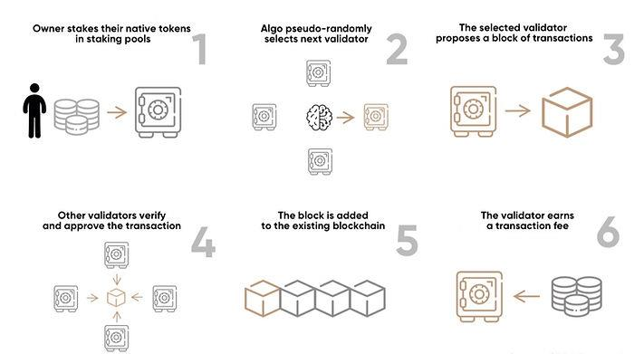
Cont. Proof of Stack

Slide 46
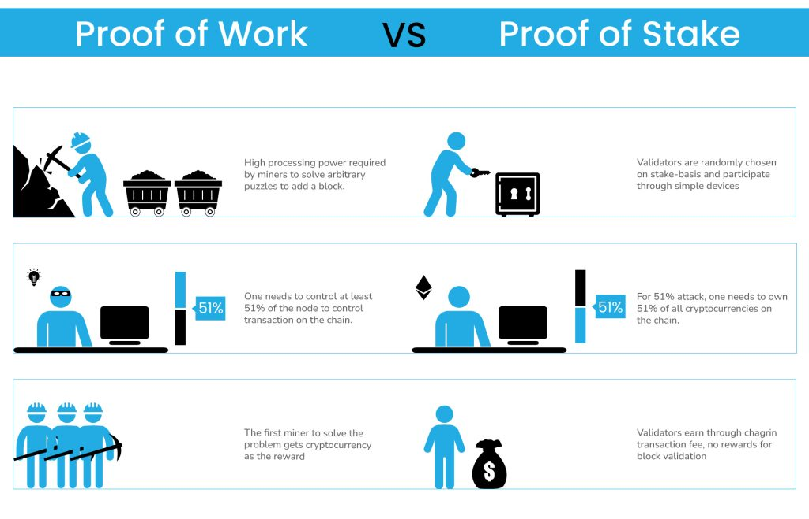
POW vs POS

Slide 47
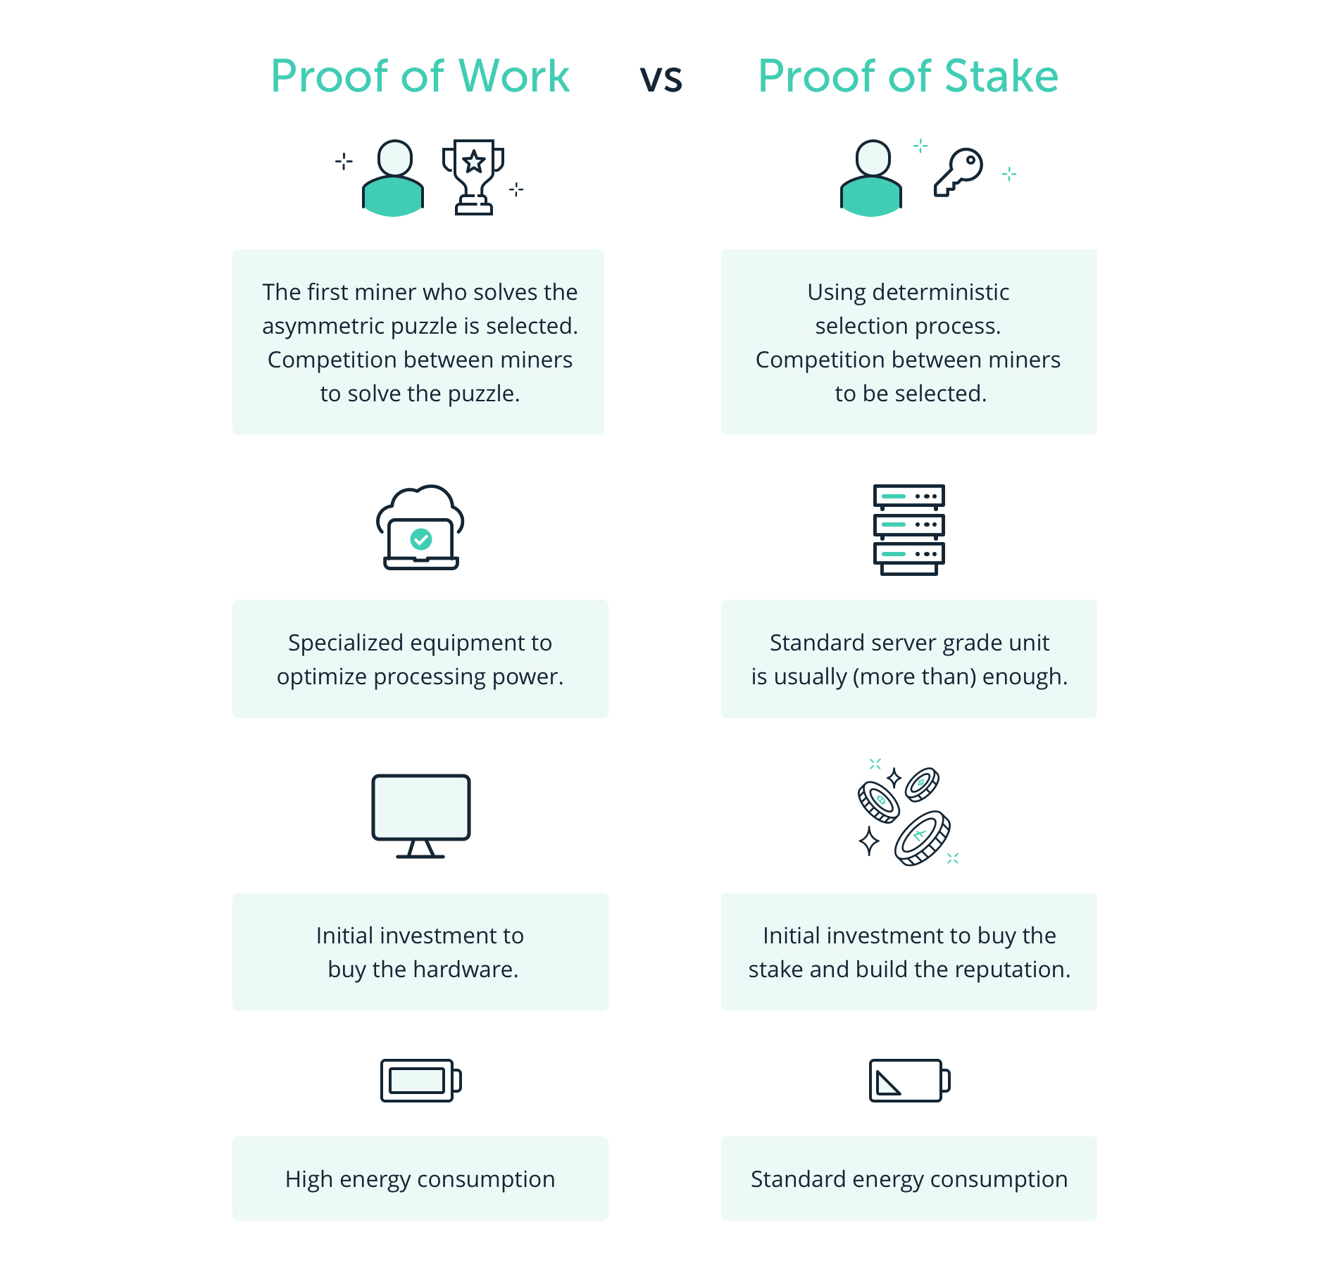
POW vs POS

Slide 48
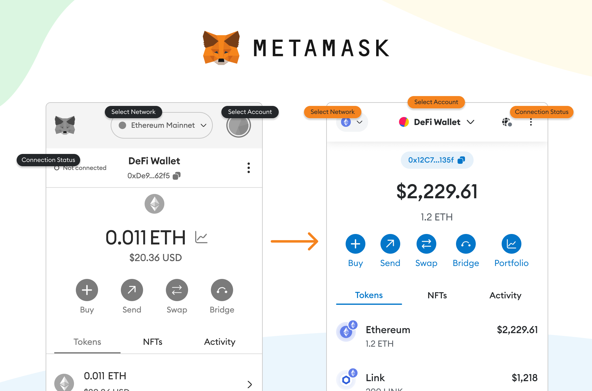
Crypto Wallets
Cryptocurrency, unlike physical cash, exists purely in the digital realm. To store and manage these digital assets, you need a crypto wallet, much like a digital vault. But unlike traditional wallets, crypto wallets hold private keys instead of your money itself.
Types of Crypto Wallets:
Hot Wallets: These are online wallets like mobile apps or browser extensions, offering convenience and accessibility. However, they're connected to the internet, making them more susceptible to hacking.
Cold Wallets: These are hardware devices like USB sticks or dedicated computers, storing your private keys offline. They offer enhanced security but lack the convenience of hot wallets.
Paper Wallets: These are printed sheets containing your private key. While extremely secure when stored safely, they can be easily lost or damaged.

Slide 49
Concepts and Principles
Blockchain: Blockchain is a type of distributed database or ledger shared among a computer network's nodes, that uses cryptography to secure its data. It is made up of a chain of blocks, each of which contains a set of transactions. The blocks are linked together using cryptography, which makes it very difficult to tamper with the data.
Nodes: Nodes are computers that participate in the blockchain network. They store blockchain data and verify new transactions.
Blocks: Blocks are the basic unit of data in a blockchain. They contain a set of transactions and a cryptographic hash of the previous block.
Transactions: Transactions are the basic unit of interaction in a blockchain. They can be used to transfer value, create contracts, or record other events.
Dapps: A short for Decentralized Applications, are applications that run on a decentralized network, typically utilizing blockchain technology. Unlike traditional applications that are hosted on centralized servers, DApps operate on a peer-to-peer network, where data and computations are distributed across multiple nodes.
DAOs: A short for Decentralized Autonomous Organizations, are organizations or entities that operate on a blockchain network using smart contracts and decentralized governance mechanisms. DAOs aim to automate decision-making, governance, and operations through code, removing the need for traditional hierarchical structures and centralized control.
Genesis block: The first block in a blockchain, used to initialize a particular network and its cryptocurrency.

Slide 50
Cont. Concepts and Principles
Tokenization: the process of representing real-world or digital assets as tokens on a blockchain network. It involves converting the ownership or rights of an asset into a digital representation, which can be traded, transferred, and recorded securely on the blockchain
Consensus: The process of validating a new block. Consensus rules: The block validation rules that full nodes follow to stay in consensus with other nodes. Not to be confused with consensus.
Digital signature: A short string of data a user produces for a document using a private key such that anyone with the corresponding public key, the signature, and the document can verify that (1) the document was “signed” by the owner of that particular private key, and (2) the document was not changed after it was signed.
ECDSA: Elliptic Curve Digital Signature Algorithm. A cryptographic algorithm used by Ethereum to ensure that funds can only be spent by their owners.

Slide 51
Cont. Concepts and Principles
IPFS : InterPlanetary File System. A protocol, network, and open source project designed to create a content-addressable, peer-to-peer method of storing and sharing hypermedia in a distributed filesystem.
IDE : Integrated Development Environment. A user interface that typically combines a code editor, compiler, runtime, and debugger
Merkle Patricia Tree : A data structure used in Ethereum to efficiently store key–value pairs .
NFT : A non-fungible token (also known as a “deed”). This is a token standard introduced by the ERC721 proposal. NFTs can be tracked and traded, but each token is unique and distinct; they are not interchangeable like ERC20 tokens. NFTs can represent ownership of digital or physical assets
Node: A software client that participates in the network.
Nonce :In cryptography, a value that can only be used once.
Ether : The native cryptocurrency used by the Ethereum ecosystem, which covers gas costs when executing smart contracts.
Wei : The smallest denomination of ether. 10¹⁸ wei = 1 ether.
Event : Allows the use of EVM logging facilities.

Slide 52
Cont. Concepts and Principles
EVM : Ethereum Virtual Machine. A stack-based virtual machine that executes bytecode.
Fork : A change in protocol causing the creation of an alternative chain, or a temporal divergence in two potential block paths during mining.
Gas : A virtual fuel used in Ethereum to execute smart contracts.
Smart Contract: A smart contract is a self-executing contract with the terms of the agreement directly written into code. It is deployed on a blockchain network and automatically executes predefined actions when specific conditions are met. Smart contracts eliminate the need for intermediaries, as they enforce the rules and facilitate transactions directly between parties.
Bytecode : An abstract instruction set designed for efficient execution by a software interpreter or a virtual machine. Unlike human-readable source code, bytecode is expressed in numeric format.
Compiling : Converting code written in a high-level programming language (e.g., Solidity) into a lower-level language (e.g., EVM bytecode).

Slide 53

The history of the web
Web 1.0 (1991-2004): The first generation of the web was characterized by static websites that were mostly read-only. Users could view and download information, but they could not interact with it in a meaningful way.

Slide 54
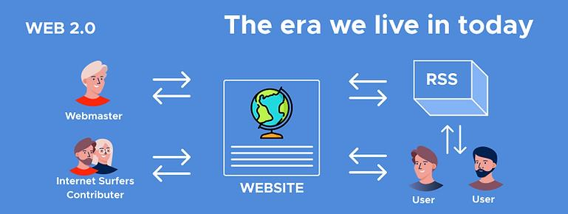
Cont.
Web 2.0 (2004-present): The second generation of the web introduced more interactivity and user-generated content. Users could now create and share their own content, and they could also interact

Slide 55
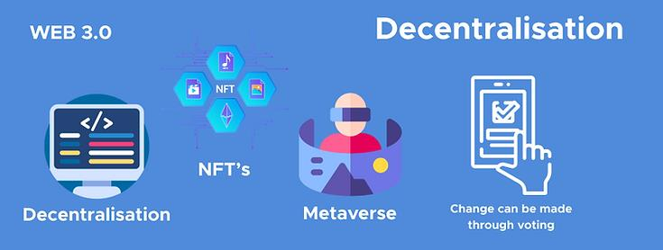
Cont.
Web 3.0 (present-day): The third generation of the web is still under development, but it is envisioned as a more decentralized and intelligent web that is powered by blockchain technology. Web 3.0 will make it possible for users to own their own data and control how it is used. It will also make it possible for machines to understand and process information more effectively, leading to more personalized and relevant experiences for users.
Its First proposed by Dr. Gavin Wood, Web3 represents a new vision and focus for web applications: from centrally owned and managed applications, to applications built on decentralized protocols.

